Slide 1


GPU Programming (in CUDA)
Spring 2019
Julian Gutierrez
Session 2 - Lab

Slide 2
Outline
Unix/Linux Tutorial and how to use the Discovery Cluster

Slide 3
Goal
To provide you with simple information of what you can do on a server and how to interact with it through different commands
We will test all of the commands and see some of the examples for bash files/scripts that we can create
This means we will go back and forth between presentation and command line

Slide 4
Hardware Resources
Discovery Cluster
The server that we will use for this tutorial
We have been assigned a reservation which allows you to have “exclusive” access to certain nodes.
I highly recommend you read the following document as it specifies how to properly use the Discovery Cluster.
Provides guidelines to use the DC under various scenarios for example, running jobs with multiple nodes, multiple GPUs, etc.
This is important if you will use it for other projects as well.
https://docs.google.com/presentation/d/1aKZzL3o5kf_RVm23YTuOLj1LI2DZFlzitA2g9w6axas/edit#slide=id.g412dc120e5_0_0
A very useful wiki (WIP)
https://github.com/NEU-ABLE-LAB/NEU_RC_HELLO

Slide 5
Accessing the Discovery Cluster
SSH
“secure shell”: a network protocol for secure data communication
Typically used to log into a remote machine and execute commands in command-line
SSH tools
In Windows: putty, MobaXterm, etc.
In Linux/Mac: ssh is already installed, can be used directly from a terminal

Slide 6
Accessing the Discovery Cluster
We will need an SSH connection.
If MAC or Linux
ssh -X yourusername@login.discovery.neu.edu.
Replace your username with your myneu id.
If you're on a mac use ssh -Y (not ssh -X)
If windows
Install PuTTY which allows you to create a connection through a terminal:
http://www.chiark.greenend.org.uk/~sgtatham/putty/latest.html
Or you can also install MobaXterm (can do SSH and SFTP):
I prefer this one as it has X forwarding by default amongst other useful features
https://mobaxterm.mobatek.net/download-home-edition.html
Install FileZilla Client software:
FileZilla will allow you to copy files back and forth from the server. It’s easier if you plan on editing the codes on your machine and then copying them back to the server.
https://filezilla-project.org/download.php?type=client

Slide 7
Accessing the Discovery Cluster Transferring Files
Two ways to transfer files
SFTP
Secure file transfer protocol
Implementation has Windows GUI (available on COE Windows machines)
FileZilla or MobaXterm are other options for your personal computer
SCP
Command line transfer
Can move a file or folder (using -r) from local computer to your account on the discovery cluster.
Example
scp localfile.txt user@gateway.coe.neu.edu:~/localfile.txt
scp user@gateway.coe.neu.edu:~/localfile.txt localfile.txt

Slide 8
Examples

Slide 9
SSH – Using MobaXterm
Open MobaXterm and click on Session (Top left) -> SSH
Remote Host: login.discovery.neu.edu
Click on Specify username
Write your username in the box
Click ok and accept any pop-up that might appear.

Slide 10
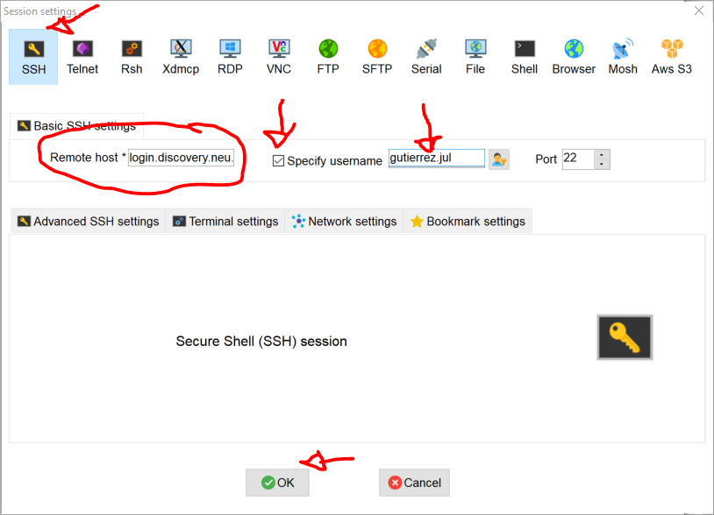
SSH – Using MobaXterm

Slide 11
SFTP – Using MobaXterm
Open MobaXterm and click on Session (Top left) -> SFTP
Remote Host: xfer-00.discovery.neu.edu
Click on Specify username
Write your username in the box
Click ok and accept any pop-up that might appear.

Slide 12
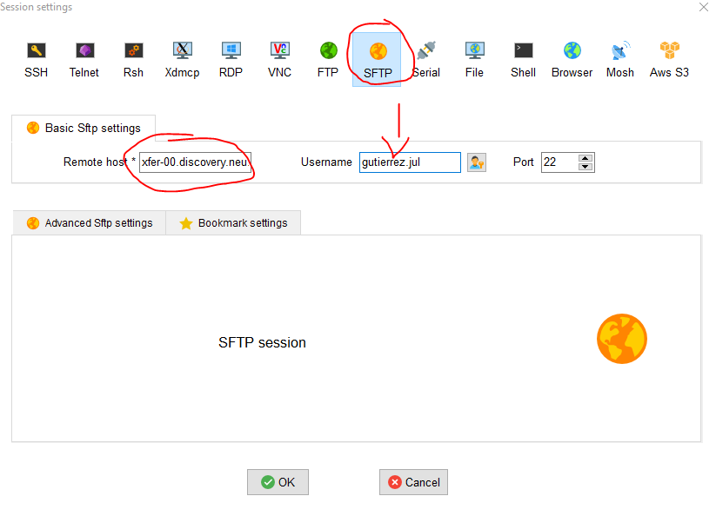
SFTP – Using MobaXterm

Slide 13
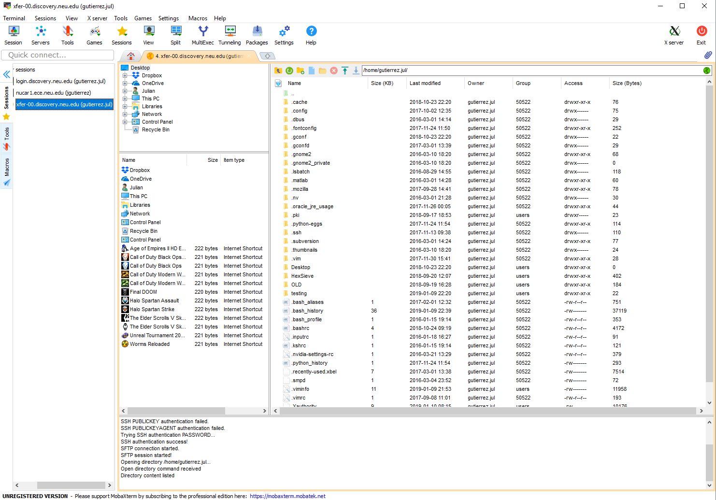
SFTP – Using MobaXterm

Slide 14
SFTP – Using FileZilla
Open FileZilla and input the following:
Host: xfer-00.discovery.neu.edu
Username: <Username>
Password: <Password>
Port: 22
Click on Quick-connect and it should be able to connect to the data transfer server.

Slide 15
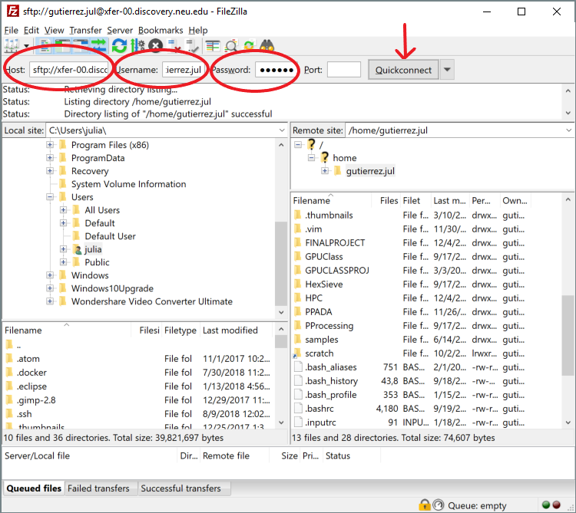
SFTP – Using FileZilla

Slide 16
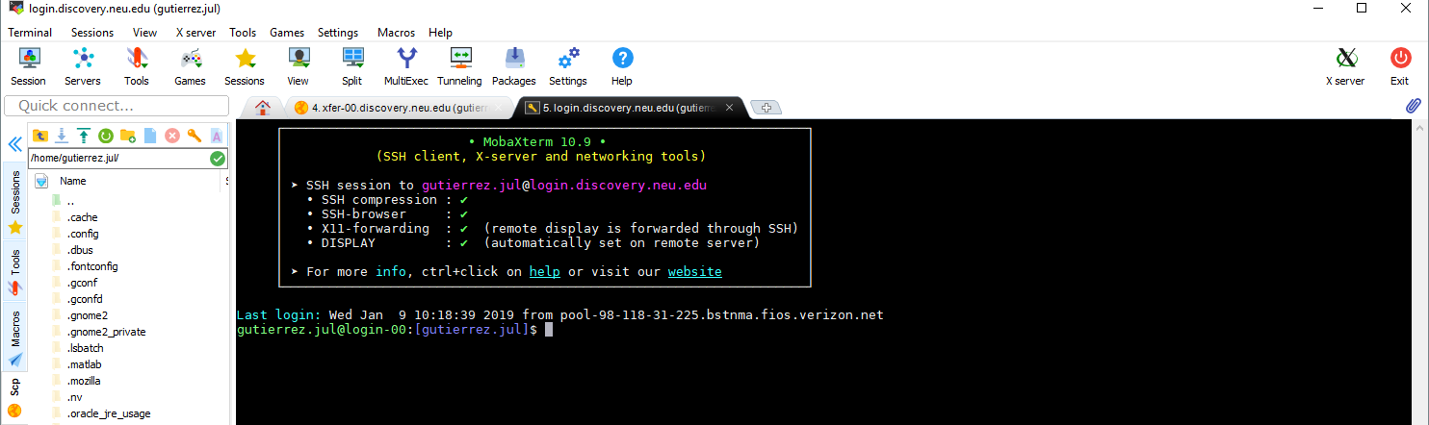
SSH – Using Linux Terminal

Slide 17
The Shell
Whenever you login to a Unix system you are placed in a program called the shell
Bottom left of your screen
To get your work done, you enter commands at this prompt
The shell acts as a command interpreter
Takes each command and passes it to the operating system kernel to be acted upon
It then displays the results of this operation on your screen
As soon as you login, the shell (bash) will execute the following file:
~\.bashrc
This file configures your shell, and you can modify it to do whatever you want
~\.bash_aliases
This file is to load any “shortcuts” you want to have

Slide 18
General Commands
Shells
Bourne Shell, Bourne-Again Shell, Korn Shell
sh, bash, ksh
Who is connected to the server/workstation?
who
Path
echo $path

Slide 19
General Commands
Executable location
whereis <filename>
Full path to Current directory
pwd
Running processes
ps
Close connection
exit

Slide 20
Navigation Commands
Change directory (can receive relative and absolute paths)
cd
cd .. (change to parent directory)
cd ~ (change to home directory)
cd / (change to root directory)
List files and folders
ls (ls -a, ls -l, etc)

Slide 21
Navigation Commands
Execute file
./a.out
Finding files
find / -name game (search starting with root)
Viewing File Content
more/less or cat
Man pages
Man <command>

Slide 22
File and Directory Commands
Copy file
cp file.doc newfile.doc
cp filename /tmp
Copy all files to a directory
cp * /home/tom/backup
Copy recursively
cp -R /currentdir/* /home/tom/backup

Slide 23
File and Directory Commands
Create directory
mkdir <dirname>
Rename file
mv <oldfile> <newfile>
Delete file
rm <filename>
Delete directory recursively
rm -R <dirname>
BE VERY CAREFUL!!!

Slide 24
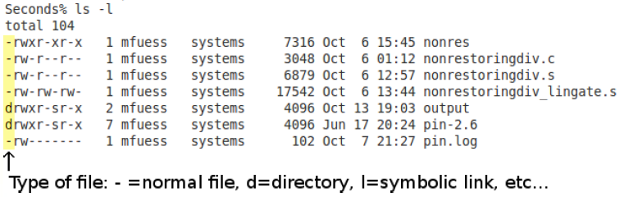
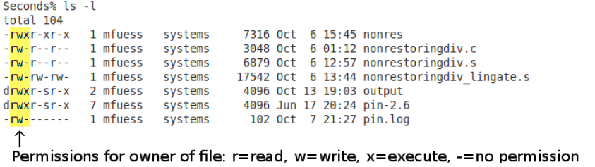
Files and Directories

Slide 25
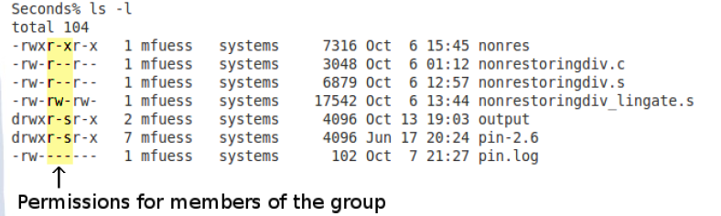
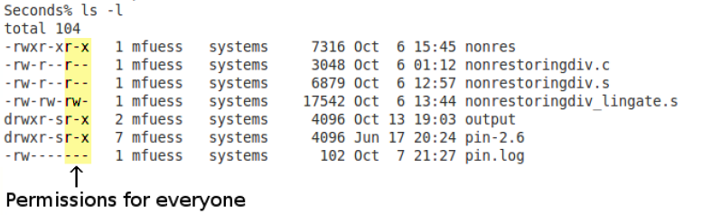
Files and Directories

Slide 26
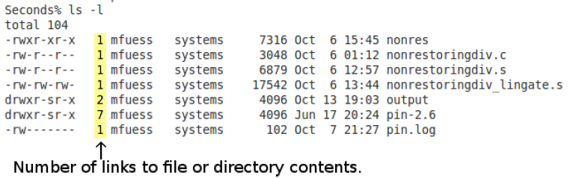
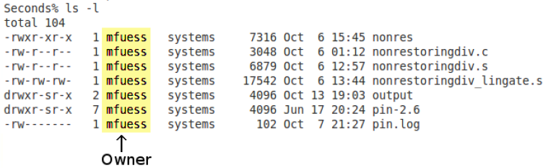
Files and Directories

Slide 27
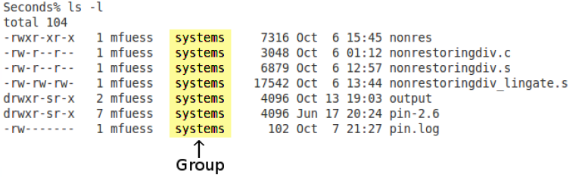
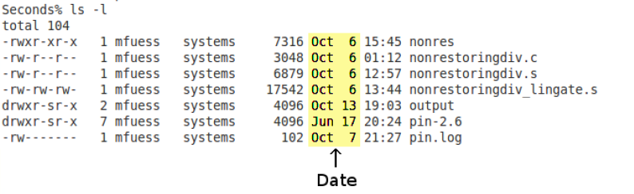
Files and Directories

Slide 28
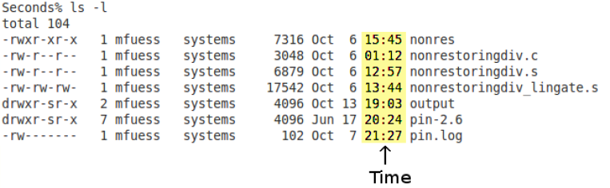
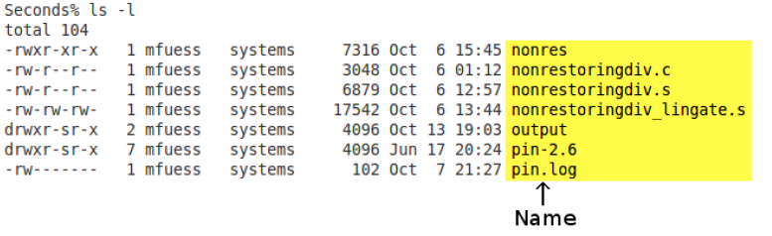
Files and Directories

Slide 29
Files and Directories
To change permissions of a file or directory you use the following command:
chmod 775 <files>
Each number applies to the permissions column as a bit mask.
There are many ways of using chmod so you can use man chmod to better understand the command.

Slide 30
gcc Compilation
Compile file
gcc myfile.c (produces a.out executable)
Build output to an output file
gcc myfile.c -o myfile
Generate assembly
gcc -S myfile.c
Compiler optimization levels
gcc -O<n> myfile.c

Slide 31
Text Editors
Emacs
Vi
Pico
Many more…

Slide 32
Vi
Console (screen) oriented text editor
Has two modes of operation
Command mode with commands which cause action to be taken on the file
Insert mode in which entered text is inserted into the file
To enter command mode hit ESC, type the command, and hit RETURN
To enter insert mode hit ESC, type i, and hit RETURN

Slide 33
Vi Commands
Start Vi
vi myfile.txt
Save modified file
ESC, :w<return>
Save modified file and exit Vi
ESC, :x<return>
Exit Vi without saving changes
ESC, :q!<return>

Slide 34
Vi Insert Mode
Can edit text
Can move cursor using arrow buttons
To enter this mode and exit command mode hit ESC and then hit s.

Slide 35
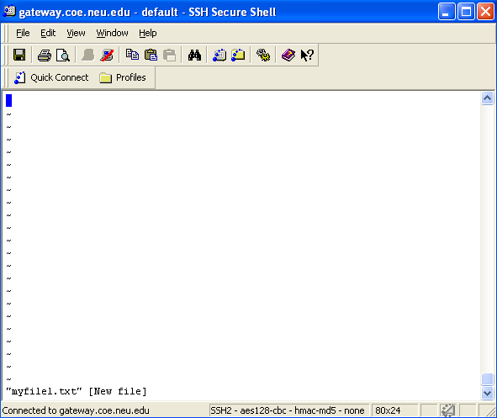
Vi User Interface

Slide 36
Advanced Commands
Pipes and redirections
Passing the output of a command to the next one
Examples:
ls -la | head -1 # transfers the output of ls command to head
cat file | grep –c # same
./command > file.log #stores command output in the file
Grep
grep searches input files for lines containing a match to a given pattern list
Sed
The sed stream editor is a text editor that performs editing operations on information coming from standard input or a file
Awk
Awk is both a programming language and text processor that can be used to manipulate text data in very useful ways

Slide 37
Using the Discovery Cluster
After setting the SSH connection to the Discovery Cluster, this will take you to a login node.
YOU SHOULD NOT execute any work here.
These nodes are meant to control the flow of users and shouldn’t be used for anything besides that (this means, no compiling/running code on them).
You should only run code by requesting a node using a SLURM script or submitting an interactive node (we will go into this shortly).

Slide 38
Using the Discovery Cluster
The discovery cluster contains different partitions (groups of nodes) which are used to differentiate the computing capabilities of the machines.
All machines from the same partition will usually have similar hardware (E.g. the gpu partition, all nodes contain gpus)
These are the main partitions available:
general
gpu
infiniband
phi
Other private ones

Slide 39
Using the Discovery Cluster
We will have a reservation which grants us exclusive access to up to 16 nodes (known as a partition or group of nodes) for us to work with during lab sessions.
They are GPU nodes with K20m GPUs (which you will need later on in the course).
This reservation (gpu-class) is available only 2 hours before and 2 hours after lab sessions.

Slide 40
Using the Discovery Cluster
We are first going to setup the environment in the discovery cluster.
We are going to store all our codes in a general folder called scratch.
Each person must create their own folder in scratch by running this command:
mkdir /scratch/`whoami`

Slide 41
Using the Discovery Cluster
The /scratch directory is a 1+ PB parallel file server which all users may utilize.
Always launch submitted jobs from /scratch, and transfer your data from /scratch to another resource (e.g. personal/group file server) as soon as possible.
For instance if you wrote code stored in scratch, you want to copy it back to your home directory as the data in /scratch might be removed after a couple of months of inactivity.

Slide 42
Using the Discovery Cluster
In order to run any code on Discovery, you must use SLURM (Simple Linux Utility for Resource Management).
The idea is that you ask SLURM for resources (e.g. what type of node, how many cores, how much memory), and then your code will execute once those resources are available.
We will go into this later on in the lab.

Slide 43
Using the Discovery Cluster
Some common SLURM Commands:
sbatch <file name> : this will send the job to the scheduler.
srun : If you would prefer to work interactively on a node, you may launch and interactive session with srun.
squeue : see what jobs are waiting and running currently.
scancel <job id> : remove a running or pending job from the queue
scontrol <flags> : find more information about the machine configuration and job settings
seff <job id> : report the computational efficiency of your calculations

Slide 44
SBATCH
In order to schedule a job for execution, you need to submit it to SLURM using the command:
sbatch sbatch_example.script
The general format for a submit script is to provide a variety of SBATCH flags in the header and then the executables are called in the body of the script.
Use sbatch --help to see all command line options available
Submission script: sbatch_example.script

Slide 45
SRUN
SRUN lets you use a node interactively. You can run your program and see the output right at your terminal.
Use srun --help to see all command line options available

Slide 46
Try It Out: sbatch and srun
Use an editor to create a file “bash_example.sh” and copy and paste this into the file:
In the next slide, we will run bash_example.sh using both srun and sbatch
#!/bin/bash
host=`/bin/hostname`
echo "HELLO FROM $host"

Slide 47
Try It Out: sbatch and srun
For srun:
srun –N 5 –p general bash_example.sh
For sbatch, first create an sbatch script file named “sbatch_example.script” and write the following lines. (Please make sure that the directory of the file is correct:
To run the sbatch script:
sbatch sbatch_example.script
#!/bin/bash
#SBATCH –p general
#SBATCH –N 5
#SBATCH –o "out.txt"
./<directory>/bash_example.sh
Output will be located in “out.txt”

Slide 48
Using the Discovery Cluster
We also want to setup our environment to have access to the tools we will use (compilers, etc).
You can do this by loading the necessary modules (cuda).
You can add the following lines at the end of your ~/.bashrc file (in your home directory).
This is the file which will be loaded every time you connect to the discovery cluster.

Slide 49
Using the Discovery Cluster
Open file using an editor
vim ~/.bashrc
Go to the end of the file and copy these lines.
module load cuda/9.0
Reload the file.
source ~/.bashrc

Slide 50
Using the Discovery Cluster
Now that we have loaded the necessary modules to compile cuda code (particularly necessary only when you start working with GPUs), we can request SLURM for resources.
submit test job
srun -p gpu --reservation=gpu-class --x11 --gres=gpu:1 nvidia-smi
Srun takes as input all the flags, and executes the last item which is the nvidia-smi command.
This will return information about the gpu on the node which was allocated for your job

Slide 51
Using the Discovery Cluster
srun --pty --export=ALL --partition=gpu --exclusive --nodes 1 --mem=2Gb --time=00:20:00 --gres=gpu:1 /bin/bash
this will log you into an interactive shell on a node in the reservation (running bash as the shell).
From there you can run any linux commands
You can run the squeue command to guarantee that you are using a compute resource. This will print the nodes allocated for the user:
squeue -u `whoami`
JOBID PARTITION NAME USER ST TIME NODES NODELIST(REASON)
678595 gpu bash gutierre R 0:48 1 c2133

Slide 52
Using the Discovery Cluster
From now on, you can compile your work.
IMPORTANT: When you are done with everything (Don’t run this right now as we will be using this compute node), type the following command to make the resources available to other users.
exit

Slide 53
Advanced Commands
Hands on experiment example
Copy /scratch/gutierrez.jul/GPUClassS19/HOL1/tutorial.tar.gz into your /scratch directory
mkdir -p /scratch/$USER/HOL1
cp /scratch/gutierrez.jul/GPUClassS19/HOL1/tutorial.tar.gz /scratch/$USER/HOL1
Unzip file
cd /scratch/$USER/HOL1
tar -zxvf tutorial.tar.gz
cd tutorial
Inside this folder, there are lots of experiments results.
Look at the directory structure.
Read some of these log files.

Slide 54
Advanced Commands
Find a command using pipes that can find the GPU execution time for all experiments for “cuda-basic”, remove the expression “Total GPU Execution Time” to just display the actual time for each file, and store it in a file.
Example output of how each line should look:
results/zorder-sobel/tree/cuda-basic/8-10.log: 2.455584 ms
results/zorder-sobel/tree/cuda-basic/8-1.log: 2.452544 ms
results/zorder-sobel/tree/cuda-basic/8-2.log: 4.310976 ms
results/zorder-sobel/tree/cuda-basic/8-3.log: 4.201568 ms
results/zorder-sobel/tree/cuda-basic/8-4.log: 4.206208 ms
results/zorder-sobel/tree/cuda-basic/8-5.log: 4.115840 ms
results/zorder-sobel/tree/cuda-basic/8-6.log: 4.255488 ms
results/zorder-sobel/tree/cuda-basic/8-7.log: 4.200832 ms

Slide 55
Advanced Commands
What would you change if you only want to keep the time for the experiment and remove everything else?
Why could this be useful?

Slide 56
Advanced Commands
Answers (there are many ways of doing this)
When you’re running multiple experiments, you can search for information and display it however you want in a very convenient manner
grep "GPU Execution Time" results/*/*/cuda-basic/*.log | sed "s/Total GPU Execution Time\: //" > file.log
grep "GPU Execution Time" results/*/*/cuda-basic/*.log | sed "s/.*Total GPU Execution Time\: //" > file2.log
grep "GPU Execution Time" results/*/*/cuda-basic/*.log | awk '{print $5 " " $6}' > file3.log

Slide 57
Simple Scripting
Look at the examples available in the scripts folder.
What do they do?
You can use these scripts as baselines for future work when you have to recollect results for multiple experiments.

Slide 58
Any questions?
How to use a command?
Use man <command>
You can ask Google!
You can use the scripts in the future for results recollection. Changes would definitely need to be made but they can serve as a baseline.
I added my .bash_aliases .bashrc and .inputrc in the tutorial file in case you want to copy them into your home directory.
Read this file, for real:
https://docs.google.com/presentation/d/1aKZzL3o5kf_RVm23YTuOLj1LI2DZFlzitA2g9w6axas/edit#slide=id.g412dc120e5_0_0

